Slide 1
Database Systems
Lab 05
Joins AND Operators

Slide 2
Joins in SQL
The JOIN keyword is used in an SQL statement to query data from two or more tables, based on a relationship between certain columns in these tables.

Slide 3
Types Of Joins
Cross Join / Cartesian Join
Inner Join / Equity Join
Outer Join
Left Outer
Right Outer
Full Outer
Self Join

Slide 4
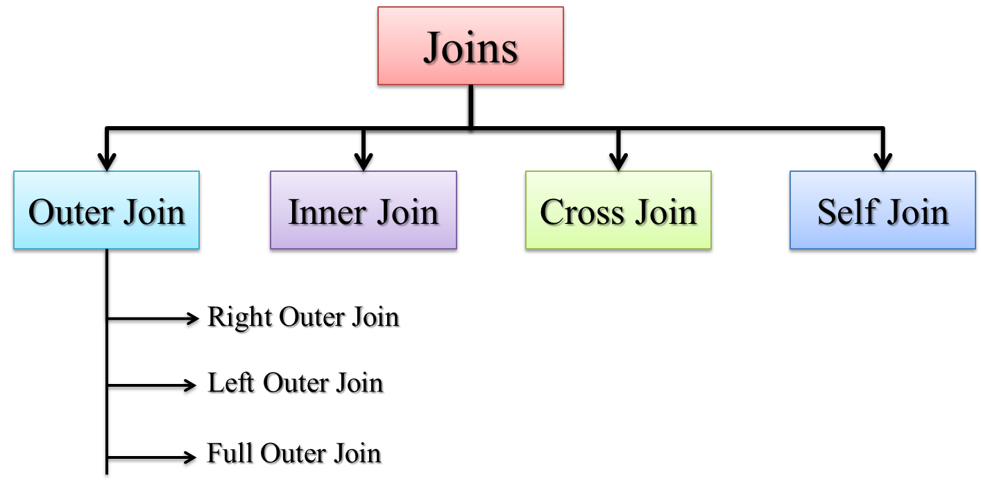
Types Of Joins

Slide 5
Cross Join / Cartesian Join
In a Cartesian join, also called a Cartesian product or cross join, each record in the first table is matched with each record in the second table.
(# rows in Table 1) * (# rows in Table 2)

Slide 6
Cartesian Join

Slide 7
Cartesian Join Example
SELECT * FROM EMP, DEPT;
ISO Standard:
SELECT * FROM EMP CROSS JOIN DEPT;

Slide 8
Inner Join / Equality Joins
If the join contains an equality condition, it is also called Equi-Join, Natural Join, Inner Join.
Example:
To retrieve the employee name, their job and department name, we need to extract data from two tables, EMP and DEPT:
SELECT E.ENAME, E.JOB, D.DNAME FROM EMP E, DEPT D WHERE E.DEPTNO = D.DEPTNO;
The SQL-1999 standard:
SELECT ENAME, JOB, DNAME FROM EMP NATURAL JOIN DEPT;

Slide 9
USING Clause
No matter how many common columns are available in the tables, NATURAL JOIN will join with all the common columns
Use USING clause to join with specified columns
Example :
SELECT EMPNO, ENAME, MGR, DNAME FROM EMP JOIN DEPT USING (DEPTNO, MGR);

Slide 10
Self Join
When a table is joined to itself then it is called as Self join or in less words we can just say “joining a table to itself is called self join”.
Example:
SELECT WORKER.ENAME, MANAGER.ENAME FROM EMP WORKER, EMP MANAGER WHERE WORKER.MGR = MANAGER.EMPNO;

Slide 11
Outer Joins
Use Outer join to return records which don’t have direct match
In outer join operation, all records from the source table included in the result even though they don't satisfy the join condition.
Syntax for Outer Joins:
SELECT column names from both tables FROM table name 1 LEFT|RIGHT|FULL OUTER JOIN table name 2 on condition;

Slide 12
Types of Outer Join
Outer joins are classified into three types: 1) Left Outer Join 2) Right Outer Join 3) Full Outer Join

Slide 13
Left Outer Join
Example
SELECT E.ENAME, D.DEPTNO, D.DNAME FROM EMP E, DEPT D WHERE E.DEPTNO = D.DEPTNO (+);
NOTE: The outer join operator appears on only that side that has information missing.
The SQL-1999 standard:
SELECT E.ENAME, D.DEPTNO, D.DNAME FROM EMP E LEFT OUTER JOIN DEPT D ON (E.DEPTNO = D.DEPTNO);

Slide 14
Right Outer Join
Example:
SELECT E.ENAME, D.DEPTNO, D.DNAME FROM EMP E, DEPT D WHERE E.DEPTNO(+) = D.DEPTNO;
The SQL-1999 standard:
SELECT E.ENAME, D.DEPTNO, D.DNAME FROM EMP E RIGHT OUTER JOIN DEPT D ON (E.DEPTNO = D.DEPTNO);

Slide 15
Full Outer Join
The SQL-1999 standard provides the following way to specify this join:
SELECT E.ENAME, D.DEPTNO, D.DNAME FROM EMP E FULL OUTER JOIN DEPT D ON (E.DEPTNO = D.DEPTNO);

Slide 16
SET OPERATORS

Slide 17
Set Operators
A
B
A
B
UNION/UNION ALL
A
B
INTERSECT
A
B
MINUS

Slide 18
UNION Operator
A
B
The UNION operator returns results from both queries after eliminating duplications.

Slide 19

Using the UNION Operator
Display the current and previous job details of all employees. Display each employee only once.
SELECT employee_id, job_id
FROM employees
UNION
SELECT employee_id, job_id
FROM job_history;
…
…

Slide 20
UNION ALL Operator
A
B
The UNION ALL operator returns results from both queries, including all duplications.

Slide 21

Using the UNION ALL Operator
Display the current and previous departments of all employees.
SELECT employee_id, job_id, department_id
FROM employees
UNION ALL
SELECT employee_id, job_id, department_id
FROM job_history
ORDER BY employee_id;
…
…

Slide 22
INTERSECT Operator
A
B
The INTERSECT operator returns rows that are common to both queries.

Slide 23

Using the INTERSECT Operator
Display the employee IDs and job IDs of those employees who currently have a job title that is the same as their job title when they were initially hired (that is, they changed jobs but have now gone back to doing their original job).
SELECT employee_id, job_id
FROM employees
INTERSECT
SELECT employee_id, job_id
FROM job_history;

Slide 24
MINUS Operator
The MINUS operator returns rows in the first query that are not present in the second query.

Slide 25
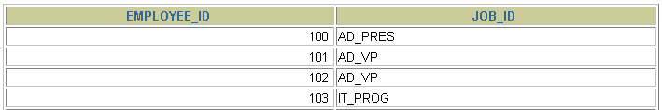

MINUS Operator
Display the employee IDs of those employees who have not changed their jobs even once.
SELECT employee_id,job_id
FROM employees
MINUS
SELECT employee_id,job_id
FROM job_history;
…

Slide 26
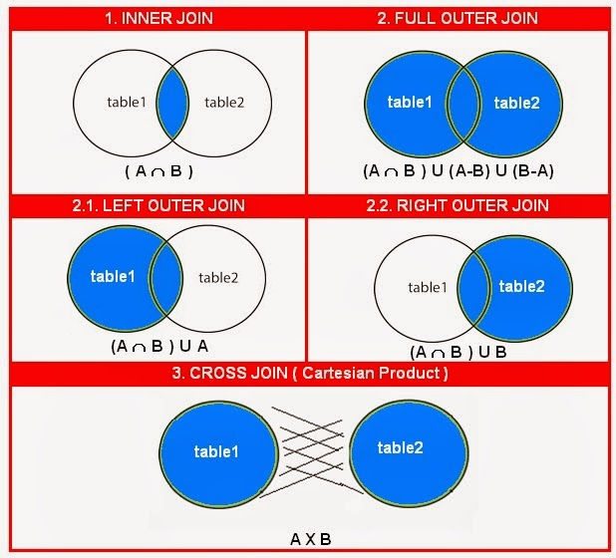
Conclusion 1

Slide 27
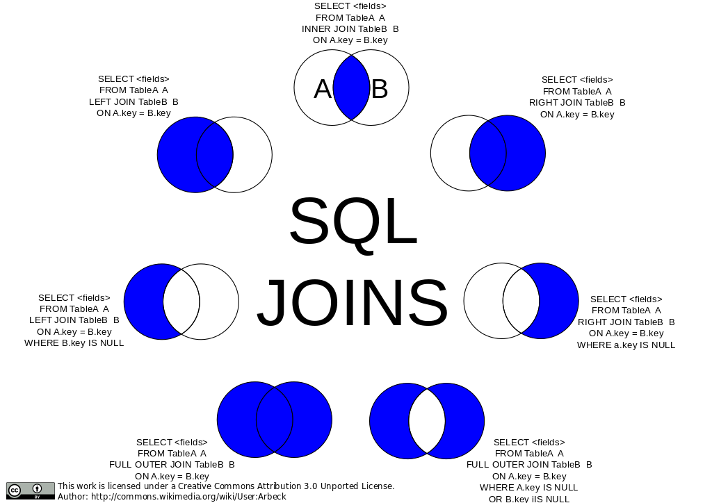
Conclusion 2

Slide 28
Exercise
Write a query to list the name, job name, department name, salary, and grade of the employees according to the department in ascending order.
Write a query to list the department where at least two employees are working
Fetch all the records where salary of employee is less than the lower salary of the employee working in SALES department .
List department number, Department name for all the departments in which there are no employees in the department.
Display employee name, salary, department name where all employees has matching department as well as employee does not have any departments. This query should include non matching rows.
List employee name, salary, department name of all employees whose salary is not within the salary grade 04.
Write a query to list the name, job name, annual salary, department id, department name and grade of the employees who earn 60000 in a year or not working as an ANALYST.
Write a query to list the employees who are senior to their own manager.
List employee name, salary, department name of all employees whose salary is within the salary grade 02.
To display all the employee’s name (including KING who has no manager) and their manager name.

